Slide 1
DATA SCIENCE machine learning / KNN
Notes:
High level, but ‘zooming in’ from last lecture

Slide 2
I. what is machine learning? iI. Supervised Learning III. Unsupervised Learning IV. Summary V. Classification with K-Nearest Neighbors
agenda

Slide 3
I. What is machine learning?
DATA SCIENCE
Notes:
~20 min

Slide 4
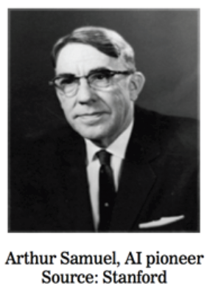
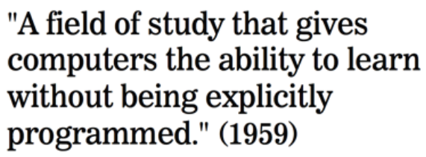
What is machine learning?
Notes:
Data-oriented

Slide 5
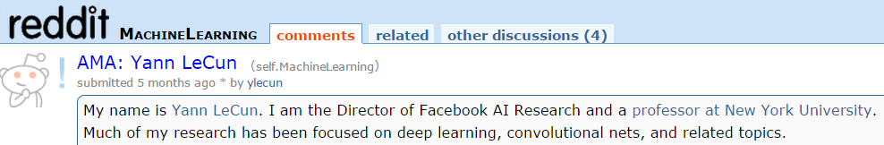
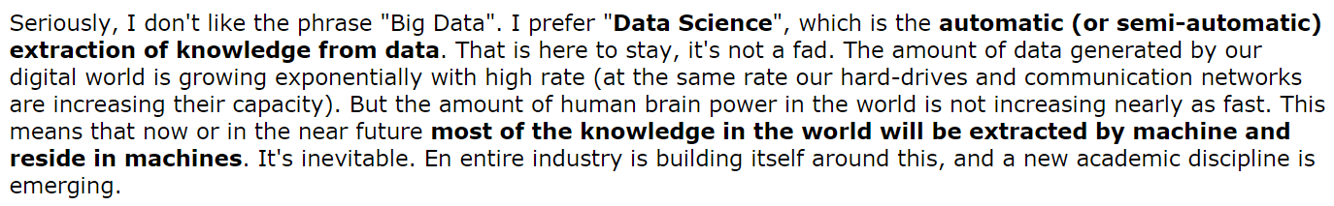
What is machine learning?
Source: http://www.reddit.com/r/MachineLearning/comments/25lnbt/ama_yann_lecun
Notes:
Data-oriented

Slide 6
What is machine learning?
From Wikipedia:
“Machine learning, a branch of artificial intelligence, is about the construction and study of systems that can learn from data.”
“The core of machine learning deals with representation and generalization…”
representation – extracting structure from data
generalization – making predictions from data
Source: http://en.wikipedia.org/wiki/Machine_learning
Notes:
Genlzn: helps you figure out what is likely to happen in the future
Keep these terms in mind…later we will use them to think about ML problems (write these on the white board)

Slide 7
Types of Machine Learning Problems
generalization
supervised making predictions
unsupervised extracting structure
representation
Notes:
“Core of ML” from before ←→ types of learning problems

Slide 8
II. Supervised Learning
DATA SCIENCE
Notes:
~20 min

Slide 9
Supervised Learning
Vector of “Predictors” X
Also known as features, independent variables, inputs, regressors, covariates, attributes
“Response” Y
Also known as outcome, label, target, dependent variable
Regression: Y is quantitative
e.g., price, blood pressure
Classification: Y is qualitative (values in a finite, unordered set)
e.g., spam/ham, digit 0-9, cancer class of tissue sample
Data is composed of “observations” (predictors and the associated response)
Also known as samples, examples, instances, records
Notes:
Embrace diversity – We have a lot of different backgrounds in terms of interests, knowledge, skills – embrace that and learn from one another
Seek an optimal pace – We will do our best to find a pace that works well for everyone – if it’s too slow for you, we will help you go deeper and give you bigger challenges – if it’s too fast for you, we will provide you with extra help and resources
Communicate early and often – We want to know how you are doing with the course, what confuses you, what learning style works for you and what doesn’t – keep us updated so we can help you to be successful
Everyone talks in class – Communication is an important data science skill, so we’re going to practice it – discuss readings, have you teach things on occasion
Success is not a grade – Success in this course is not about grades (we don’t give out grades) or about how you do compared to your classmates, it’s about achieving your goal and helping you to get where you want to be
We don’t know everything – We’ll tell you if we don’t know something, but we’ll also get you a good answer

Slide 10
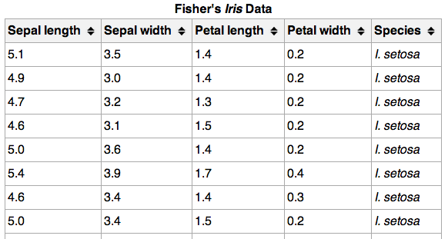
Supervised Learning
}
{
150 observations
(n = 150)
{
response
4 predictors (p = 4)
Notes:
Class label = target variable, the thing we want to predict

Slide 11
Supervised Learning
Objectives of Supervised Learning:
Accurately predict unseen test cases
Understand which predictors affect the response, and how
Assess the quality of our predictions
Notes:
Embrace diversity – We have a lot of different backgrounds in terms of interests, knowledge, skills – embrace that and learn from one another
Seek an optimal pace – We will do our best to find a pace that works well for everyone – if it’s too slow for you, we will help you go deeper and give you bigger challenges – if it’s too fast for you, we will provide you with extra help and resources
Communicate early and often – We want to know how you are doing with the course, what confuses you, what learning style works for you and what doesn’t – keep us updated so we can help you to be successful
Everyone talks in class – Communication is an important data science skill, so we’re going to practice it – discuss readings, have you teach things on occasion
Success is not a grade – Success in this course is not about grades (we don’t give out grades) or about how you do compared to your classmates, it’s about achieving your goal and helping you to get where you want to be
We don’t know everything – We’ll tell you if we don’t know something, but we’ll also get you a good answer

Slide 12
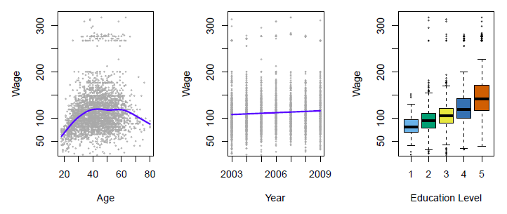
Regression Example
Establish the relationship between salary and demographic variables in population survey data
Income survey data for males from the central Atlantic region of the USA in 2009
Source: https://class.stanford.edu/c4x/HumanitiesScience/StatLearning/asset/introduction.pdf
Notes:
Embrace diversity – We have a lot of different backgrounds in terms of interests, knowledge, skills – embrace that and learn from one another
Seek an optimal pace – We will do our best to find a pace that works well for everyone – if it’s too slow for you, we will help you go deeper and give you bigger challenges – if it’s too fast for you, we will provide you with extra help and resources
Communicate early and often – We want to know how you are doing with the course, what confuses you, what learning style works for you and what doesn’t – keep us updated so we can help you to be successful
Everyone talks in class – Communication is an important data science skill, so we’re going to practice it – discuss readings, have you teach things on occasion
Success is not a grade – Success in this course is not about grades (we don’t give out grades) or about how you do compared to your classmates, it’s about achieving your goal and helping you to get where you want to be
We don’t know everything – We’ll tell you if we don’t know something, but we’ll also get you a good answer

Slide 13
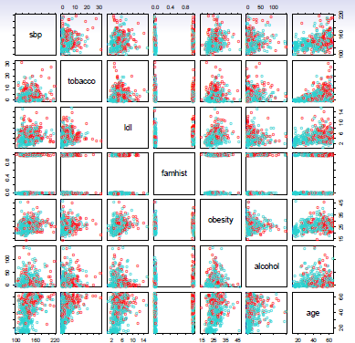
Classification Example
Predict whether someone will have a heart attack on the basis of demographic, diet and clinical measurements
Case-control sample of men from South Africa
Red = heart disease
Blue = no heart disease
Source: https://class.stanford.edu/c4x/HumanitiesScience/StatLearning/asset/introduction.pdf
Notes:
Embrace diversity – We have a lot of different backgrounds in terms of interests, knowledge, skills – embrace that and learn from one another
Seek an optimal pace – We will do our best to find a pace that works well for everyone – if it’s too slow for you, we will help you go deeper and give you bigger challenges – if it’s too fast for you, we will provide you with extra help and resources
Communicate early and often – We want to know how you are doing with the course, what confuses you, what learning style works for you and what doesn’t – keep us updated so we can help you to be successful
Everyone talks in class – Communication is an important data science skill, so we’re going to practice it – discuss readings, have you teach things on occasion
Success is not a grade – Success in this course is not about grades (we don’t give out grades) or about how you do compared to your classmates, it’s about achieving your goal and helping you to get where you want to be
We don’t know everything – We’ll tell you if we don’t know something, but we’ll also get you a good answer

Slide 14
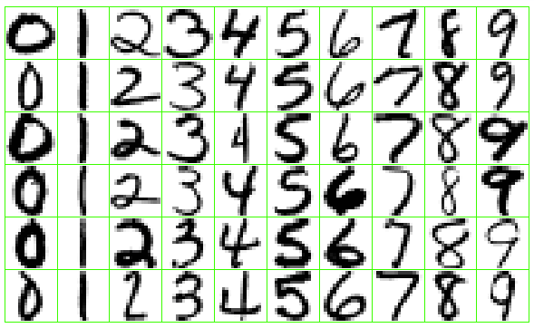
Classification Example
Identify the numbers in a handwritten zip code
Source: https://class.stanford.edu/c4x/HumanitiesScience/StatLearning/asset/introduction.pdf
Notes:
Embrace diversity – We have a lot of different backgrounds in terms of interests, knowledge, skills – embrace that and learn from one another
Seek an optimal pace – We will do our best to find a pace that works well for everyone – if it’s too slow for you, we will help you go deeper and give you bigger challenges – if it’s too fast for you, we will provide you with extra help and resources
Communicate early and often – We want to know how you are doing with the course, what confuses you, what learning style works for you and what doesn’t – keep us updated so we can help you to be successful
Everyone talks in class – Communication is an important data science skill, so we’re going to practice it – discuss readings, have you teach things on occasion
Success is not a grade – Success in this course is not about grades (we don’t give out grades) or about how you do compared to your classmates, it’s about achieving your goal and helping you to get where you want to be
We don’t know everything – We’ll tell you if we don’t know something, but we’ll also get you a good answer

Slide 15
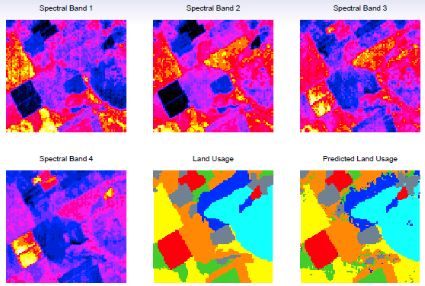
Classification Example
Classify the pixels in a LANDSAT image, by land usage
Satellite images of rural Australia
Land usage hand-labeled as one of six categories
Goal: Predict land usage using spectral bands at four frequencies
Source: https://class.stanford.edu/c4x/HumanitiesScience/StatLearning/asset/introduction.pdf
Notes:
Embrace diversity – We have a lot of different backgrounds in terms of interests, knowledge, skills – embrace that and learn from one another
Seek an optimal pace – We will do our best to find a pace that works well for everyone – if it’s too slow for you, we will help you go deeper and give you bigger challenges – if it’s too fast for you, we will provide you with extra help and resources
Communicate early and often – We want to know how you are doing with the course, what confuses you, what learning style works for you and what doesn’t – keep us updated so we can help you to be successful
Everyone talks in class – Communication is an important data science skill, so we’re going to practice it – discuss readings, have you teach things on occasion
Success is not a grade – Success in this course is not about grades (we don’t give out grades) or about how you do compared to your classmates, it’s about achieving your goal and helping you to get where you want to be
We don’t know everything – We’ll tell you if we don’t know something, but we’ll also get you a good answer

Slide 16
III. UNSupervised Learning
DATA SCIENCE
Notes:
~20 min

Slide 17
UNSupervised Learning
No response variable Y, just a set of predictors X
Objective is more fuzzy:
Find groups of observations that behave similarly
Find predictors that behave similarly
Find linear combinations of features that explain most of the variation in the data
Difficult to evaluate how well you are doing
Data is easier to obtain for unsupervised learning since it can be “unlabeled”
Sometimes useful as a preprocessing step for supervised learning
Common techniques: clustering, principal components analysis
Notes:
Embrace diversity – We have a lot of different backgrounds in terms of interests, knowledge, skills – embrace that and learn from one another
Seek an optimal pace – We will do our best to find a pace that works well for everyone – if it’s too slow for you, we will help you go deeper and give you bigger challenges – if it’s too fast for you, we will provide you with extra help and resources
Communicate early and often – We want to know how you are doing with the course, what confuses you, what learning style works for you and what doesn’t – keep us updated so we can help you to be successful
Everyone talks in class – Communication is an important data science skill, so we’re going to practice it – discuss readings, have you teach things on occasion
Success is not a grade – Success in this course is not about grades (we don’t give out grades) or about how you do compared to your classmates, it’s about achieving your goal and helping you to get where you want to be
We don’t know everything – We’ll tell you if we don’t know something, but we’ll also get you a good answer

Slide 18
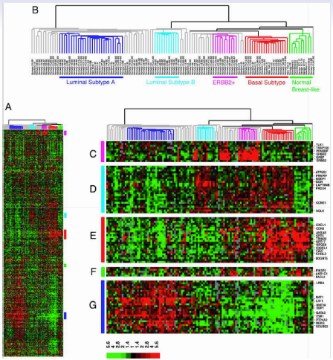
Clustering Example
Classify a tissue sample into one of several cancer classes, based on a gene expression
Gene expression data
Each row is a gene (p=8000)
Each column is a woman with breast cancer (n=88)
Heatmap represents level of gene expression for each gene and each patient
Goal: Locate subcategories of breast cancer showing different gene expressions
Technique: Hierarchical clustering applied to the columns, resulting in six sub-groups of patients
Source: https://class.stanford.edu/c4x/HumanitiesScience/StatLearning/asset/introduction.pdf
Notes:
Embrace diversity – We have a lot of different backgrounds in terms of interests, knowledge, skills – embrace that and learn from one another
Seek an optimal pace – We will do our best to find a pace that works well for everyone – if it’s too slow for you, we will help you go deeper and give you bigger challenges – if it’s too fast for you, we will provide you with extra help and resources
Communicate early and often – We want to know how you are doing with the course, what confuses you, what learning style works for you and what doesn’t – keep us updated so we can help you to be successful
Everyone talks in class – Communication is an important data science skill, so we’re going to practice it – discuss readings, have you teach things on occasion
Success is not a grade – Success in this course is not about grades (we don’t give out grades) or about how you do compared to your classmates, it’s about achieving your goal and helping you to get where you want to be
We don’t know everything – We’ll tell you if we don’t know something, but we’ll also get you a good answer

Slide 19
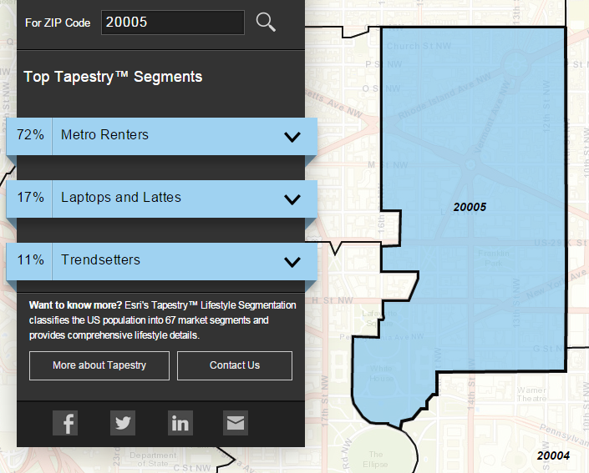
Clustering Example
Classify US residential neighborhoods into 67 unique segments based on demographic and socioeconomic characteristics
Metro Renters:
Young, mobile, educated, or still in school, we live alone or with a roommate in rented apartments or condos in the center of the city. Long hours and hard work don’t deter us; we’re willing to take risks to get to the top of our professions… We buy groceries at Whole Foods and Trader Joe’s and shop for clothes at Banana Republic, Nordstrom, and Gap. We practice yoga, go skiing, and attend Pilates sessions.
Source: http://www.esri.com/landing-pages/tapestry/
Notes:
Embrace diversity – We have a lot of different backgrounds in terms of interests, knowledge, skills – embrace that and learn from one another
Seek an optimal pace – We will do our best to find a pace that works well for everyone – if it’s too slow for you, we will help you go deeper and give you bigger challenges – if it’s too fast for you, we will provide you with extra help and resources
Communicate early and often – We want to know how you are doing with the course, what confuses you, what learning style works for you and what doesn’t – keep us updated so we can help you to be successful
Everyone talks in class – Communication is an important data science skill, so we’re going to practice it – discuss readings, have you teach things on occasion
Success is not a grade – Success in this course is not about grades (we don’t give out grades) or about how you do compared to your classmates, it’s about achieving your goal and helping you to get where you want to be
We don’t know everything – We’ll tell you if we don’t know something, but we’ll also get you a good answer

Slide 20
IV. Summary
DATA SCIENCE
Notes:
~20 min

Slide 21
Supervised Vs. Unsupervised Learning
continuous categorical
supervised regression classification
unsupervised dimension reduction clustering
Notes:
Q: do you know of any particular models/algorithms that fit into these categories?
Classification for targeting ads (likely purchasers), regression, clustering (recsys), dim reduction (mtx decomposition)
Combo: nnmf (netflix prize)

Slide 22

Supervised Vs. Unsupervised Learning
What type of problem is this?
Music Recommendation
It could be either.
Supervised Learning:
Predict which songs a user will ‘thumbs up’
Unsupervised Learning:
Cluster songs based on attributes and recommend songs in the same group
Notes:
Q: do you know of any particular models/algorithms that fit into these categories?
Classification for targeting ads (likely purchasers), regression, clustering (recsys), dim reduction (mtx decomposition)
Combo: nnmf (netflix prize)

Slide 23
Machine Learning Vs. Statistical Learning
Machine learning arose as a subfield of Artificial Intelligence
Statistical learning arose as a subfield of Statistics
There is much overlap:
Machine learning has a greater emphasis on large-scale applications and prediction accuracy
Statistical learning emphasizes models and their interpretability, and precision and uncertainty
The distinction has become more and more blurred
Machine learning has the upper-hand in marketing!
Source: https://class.stanford.edu/c4x/HumanitiesScience/StatLearning/asset/introduction.pdf
Notes:
Embrace diversity – We have a lot of different backgrounds in terms of interests, knowledge, skills – embrace that and learn from one another
Seek an optimal pace – We will do our best to find a pace that works well for everyone – if it’s too slow for you, we will help you go deeper and give you bigger challenges – if it’s too fast for you, we will provide you with extra help and resources
Communicate early and often – We want to know how you are doing with the course, what confuses you, what learning style works for you and what doesn’t – keep us updated so we can help you to be successful
Everyone talks in class – Communication is an important data science skill, so we’re going to practice it – discuss readings, have you teach things on occasion
Success is not a grade – Success in this course is not about grades (we don’t give out grades) or about how you do compared to your classmates, it’s about achieving your goal and helping you to get where you want to be
We don’t know everything – We’ll tell you if we don’t know something, but we’ll also get you a good answer

Slide 24
V. Classification with K-Nearest Neighbors
DATA SCIENCE

Slide 25

Classification problems
continuous categorical
supervised regression classification
unsupervised dimension reduction clustering
Notes:
Supervised learning problem w/ categorical target variables
→ What do these terms mean?

Slide 26
Classification Problems
}
{
150 observations
(n = 150)
{
response
4 predictors (p = 4)
Notes:
Class label = target variable, the thing we want to predict

Slide 27
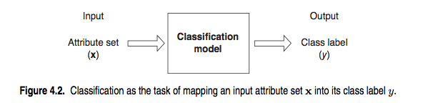
Classification problems
Q: How does a classification problem work?
A: Data in, predicted labels out.
Source: http://www-users.cs.umn.edu/~kumar/dmbook/ch4.pdf

Slide 28
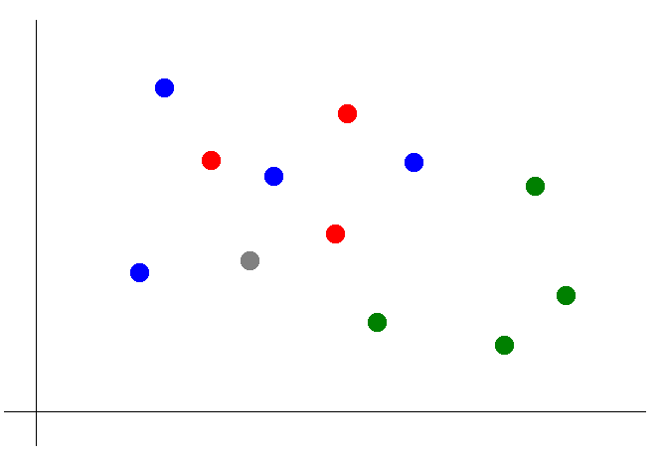

Classification with KNN
Suppose we want to predict the color of the gray dot.
QUESTION:
What are the predictors? What is the response?

Slide 29
Classification with KNN
Suppose we want to predict the color of the gray dot.
1) Pick a value for k.
k = 3

Slide 30
Classification with KNN
Suppose we want to predict the color of the gray dot.
1) Pick a value for k.
2) Find colors of k nearest neighbors.
k = 3

Slide 31
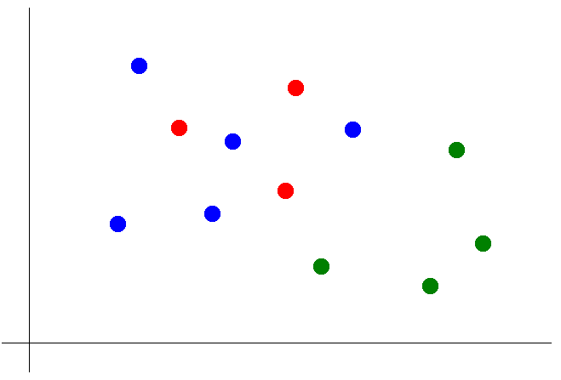
Classification with KNN
Suppose we want to predict the color of the gray dot.
1) Pick a value for k.
2) Find colors of k nearest neighbors.
3) Assign the most common color
to the grey dot.

Slide 32
Classification with KNN
Suppose we want to predict the color of the gray dot.
1) Pick a value for k.
2) Find colors of k nearest neighbors.
3) Assign the most common color
to the grey dot.
NOTE:
Our definition of “nearest” implicitly uses the Euclidean distance function.
Notes:
We will have more to say about distance functions later

Slide 33
Classification with KNN
Advantages of KNN:
Simple to understand and explain
Model training phase is fast
Non-parametric (does not presume a “form” of the “decision boundary”)
Disadvantages of KNN:
Prediction phase can be slow when n is large
Parametric methods will be better than KNN if the selected form is close to the “true” form
Parametric methods tend to be better than KNN for small n and large p
Does not provide coefficients or p-values
Sensitive to irrelevant features
Sensitive to unscaled data
Notes:
Embrace diversity – We have a lot of different backgrounds in terms of interests, knowledge, skills – embrace that and learn from one another
Seek an optimal pace – We will do our best to find a pace that works well for everyone – if it’s too slow for you, we will help you go deeper and give you bigger challenges – if it’s too fast for you, we will provide you with extra help and resources
Communicate early and often – We want to know how you are doing with the course, what confuses you, what learning style works for you and what doesn’t – keep us updated so we can help you to be successful
Everyone talks in class – Communication is an important data science skill, so we’re going to practice it – discuss readings, have you teach things on occasion
Success is not a grade – Success in this course is not about grades (we don’t give out grades) or about how you do compared to your classmates, it’s about achieving your goal and helping you to get where you want to be
We don’t know everything – We’ll tell you if we don’t know something, but we’ll also get you a good answer

Slide 34
DATA SCIENCE
Notes:
~20 min
Q: what do you think of the math we saw?
Q: how do you like using R?
Q: does anything seem mysterious?

